Slide 1
Programming Fundamentals
Lecture 26

Slide 2
Objectives
File Handling using Streams
Operations in File Handling
File Operation Modes
Error Status Bits
Writing Data to a File
Reading Data from a File
Reading Embedded Spaces in String

Slide 3
File Handling using Streams
File represents storage medium for storing data or information
Streams refer to sequence of bytes
In Files we store data i.e. text or binary data permanently and use these data to read or write in the form of input output operations by transferring bytes of data
So we use the term File Streams/File handling
The <fstream> library allows us to work with files
To use the fstream library, we need to include both the standard <iostream> AND the <fstream> header files

Slide 4
Data Types in File Handling
There are three data types included in the fstream library, which are used to create, write or read files:
ofstream
  It represents output Stream and this is used for writing in files
ifstream
  It represents input Stream and this is used for reading from files
fstream
  It represents both output Stream and input Stream. So it can read from files and write to files

Slide 5
Operations in File Handling
There are four major functions in file handling
Create
  To create a file we use open() function
Write
  To write the data to a file we use write() function
Read
  To read the data from a file we use read() function
Close
  To close a file we use close() function

Slide 6
Creating/Opening a File
Generally, the first operation performed on an object of one of these stream classes is to associate it to a real file. This procedure is known to open a file
The syntax to create/open a file is
  fstream object_name;
  object_name.open(“File_Name.txt”,ios::mode);
Here ios is a class name which contains the definitions of formatting flags, the error-status flags, and the file operation mode
The available modes are discussed in the next slide

Slide 7
File Operation Modes
The second argument in the open() function represents the mode in which the file has to be opened
The following modes are used as per the requirements
Mode | Description
in | Opens the file to read(default for ifstream)
out | Opens the file to write(default for ofstream)
binary | Opens the file in binary mode
app | Opens the file and appends all the outputs at the end
ate | Opens the file and moves the control to the end of the file
trunc | Removes the data in the existing file
nocreate | Opens the file only if it already exists
noreplace | Opens the file only if it does not already exist

Slide 8
Default Open Modes
Here are default open modes for ofstream, ifstream and fstream classes
ofstream
  ios::out
ifstream
  ios::in
fstream
  ios::in | ios::out
We can combine multiple modes by using OR | operator
  new_file.open(“new_file.txt”, ios::out | ios::app );

Slide 9
Error Status Bits
The stream error-status flags constitute an ios enum member that reports errors that occurred in an input or output operation
Various ios functions can be used to read (or set) these error flags
Name | Meaning
goodbit | No errors (no flags set, value = 0)
eofbit | Reached end of file
failbit | Operation failed (user error, premature EOF)
badbit | Invalid operation (no associated streambuf)
Hardfail | Unrecoverable error
Function | Purpose
eof() | Returns true if EOF flag set
fail() | Returns true if failbit or badbit or hardfail flag set
bad() | Returns true if badbit or hardfail flag set
good() | Returns true if everything OK; no flags set

Slide 10
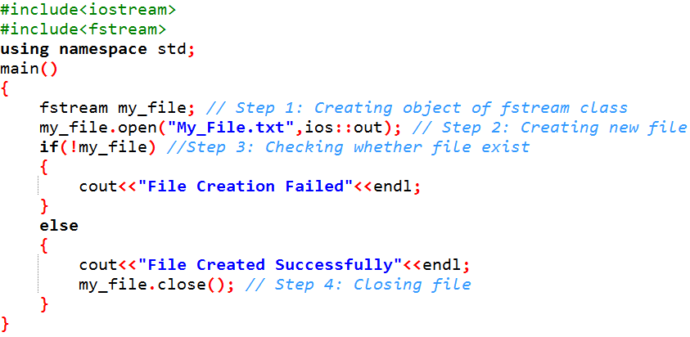
Creating a File
Here is the code for creating a file
The created file is saved in the same directory in which you are saving this .cpp code

Slide 11

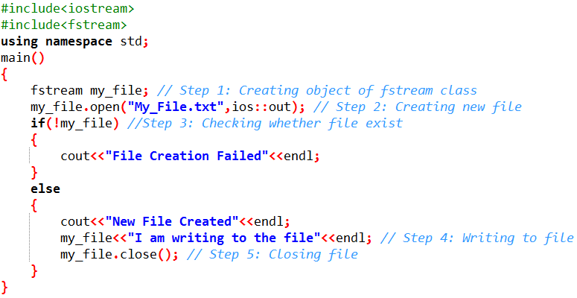
Writing to a File
Using a stream insertion operator << we can write information to a file

Slide 12
Writing a Mixed Data to the File
If the data is a mixture of multiple types like int, char, double, string etc
Then we separate the different types by a space while writing the data to the file
You may also use \n or endl
See the attached file “writing_mixed_data_to_file”

Slide 13
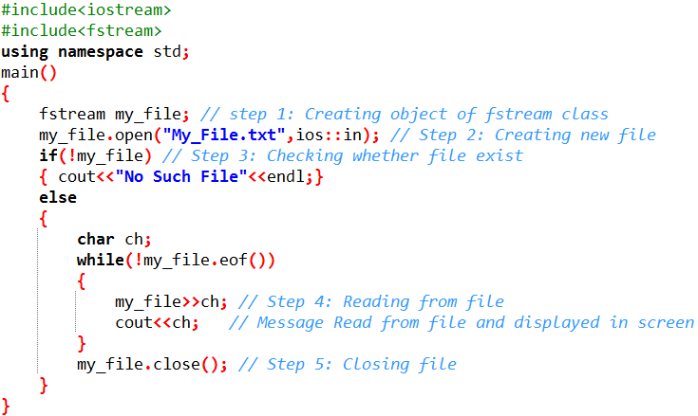

Reading From a File
Using stream extraction operator >> we can read information from a file
To read a file we need to use ‘in’ mode with syntax ios::in

Slide 14
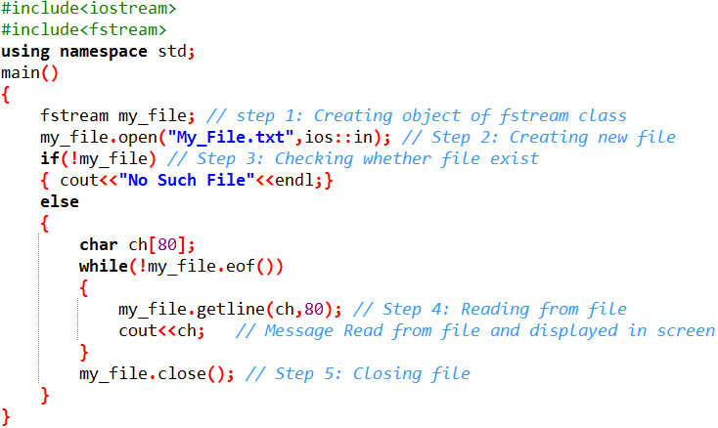

Reading Empty Spaces
The output prints without any space because we use only one character at a time, we need to use getline() with a character array to print the whole line as it is

Slide 15
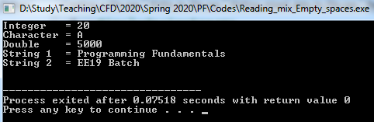
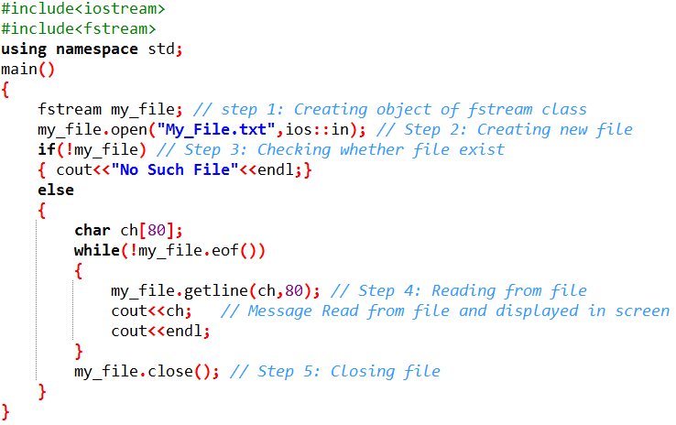
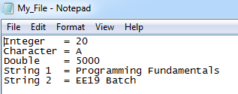
Reading a Mixed Data with Empty Spaces

